Slide 1
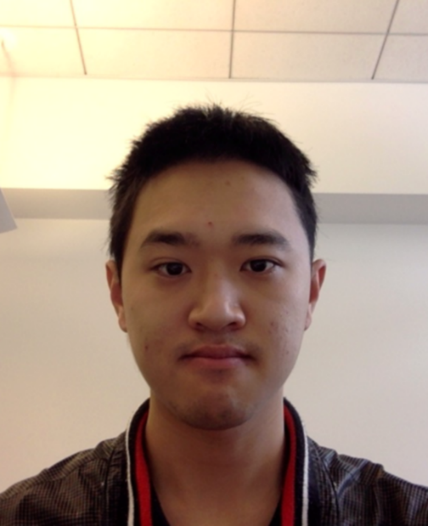
Learning Mixtures of Linear Regressions with Nearly Optimal Complexity
Yingyu Liang@UW-Madison
Joint work with Yuanzhi Li@Princeton, to appear in COLT’18

Slide 2

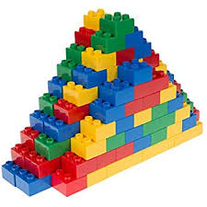
Mixture Models
General way to build sophisticated models from simple models
Notes:
General way; assuming the data can be explained by a mixture of simple models.
Example: MoG, topics
This work considers a different setting, that is, the supervised learning setting. Arguably the most simple model in this setting is just linear regression, so we consider mixture of linear regressions.

Slide 3
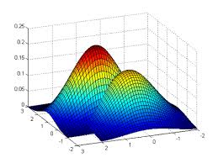
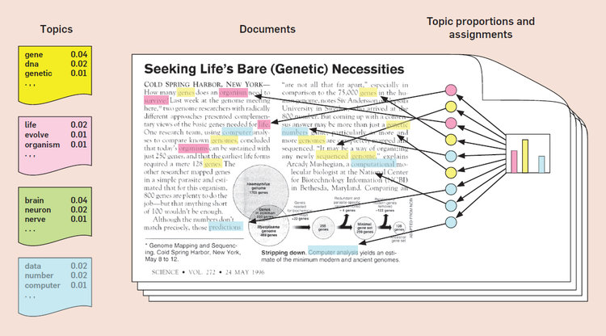
Mixture Models
General way to build sophisticated models from simple models
Widely studied in theory and practice
Mixture of Gaussians
Topic Modelling
Notes:
General way; assuming the data can be explained by a mixture of simple models.
Example: MoG, topics
This work considers a different setting, that is, the supervised learning setting. Arguably the most simple model in this setting is just linear regression, so we consider mixture of linear regressions.

Slide 4
Mixture Models
General way to build sophisticated models from simple models
Widely studied in theory and practice
  Mostly about unsupervised learning
This work: a prototypical mixture model in supervised learning, Mixture of Linear Regressions (MLR)
Notes:
General way; assuming the data can be explained by a mixture of simple models.
Example: MoG, topics
This work considers a different setting, that is, the supervised learning setting. Arguably the most simple model in this setting is just linear regression, so we consider mixture of linear regressions.

Slide 5
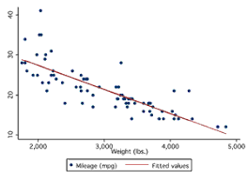
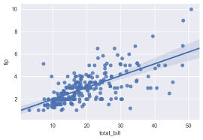
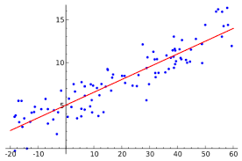

Mixture of Linear Regressions (MLR)
Given: a mixture of data points from $k$ unknown linear regression components (without knowing which point belong to which component)
Goal: learn the hidden parameters in the $k$ regressions
Mixed Data
Notes:
Assume there are k unknown linear models we called components, and we get some data points from each of these components, but we don’t know which point belongs to which component. The goal is to recover the regression weight parameters in these components.

Slide 6
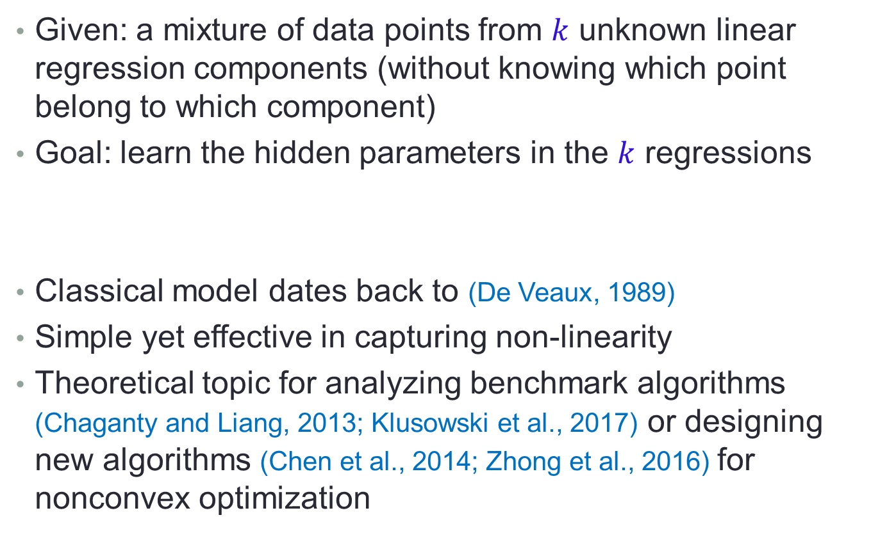
Mixture of Linear Regressions (MLR)
Given: a mixture of data points from $k$ unknown linear regression components (without knowing which point belong to which component)
Goal: learn the hidden parameters in the $k$ regressions
Classical model dates back to (De Veaux, 1989)
Simple yet effective in capturing non-linearity
Theoretical topic for analyzing benchmark algorithms (Chaganty and Liang, 2013; Klusowski et al., 2017) or designing new algorithms (Chen et al., 2014; Zhong et al., 2016) for nonconvex optimization
Notes:
This is a classical model dates back several decades ago. It has been used in practice since it’s simple but still able to capture the non-linearity in some practical data. It’s also a recent theoretical topic for analyzing benchmark algos like expectation-maximization algo for nonconvex opt; or designing new algorithms
5 min

Slide 7
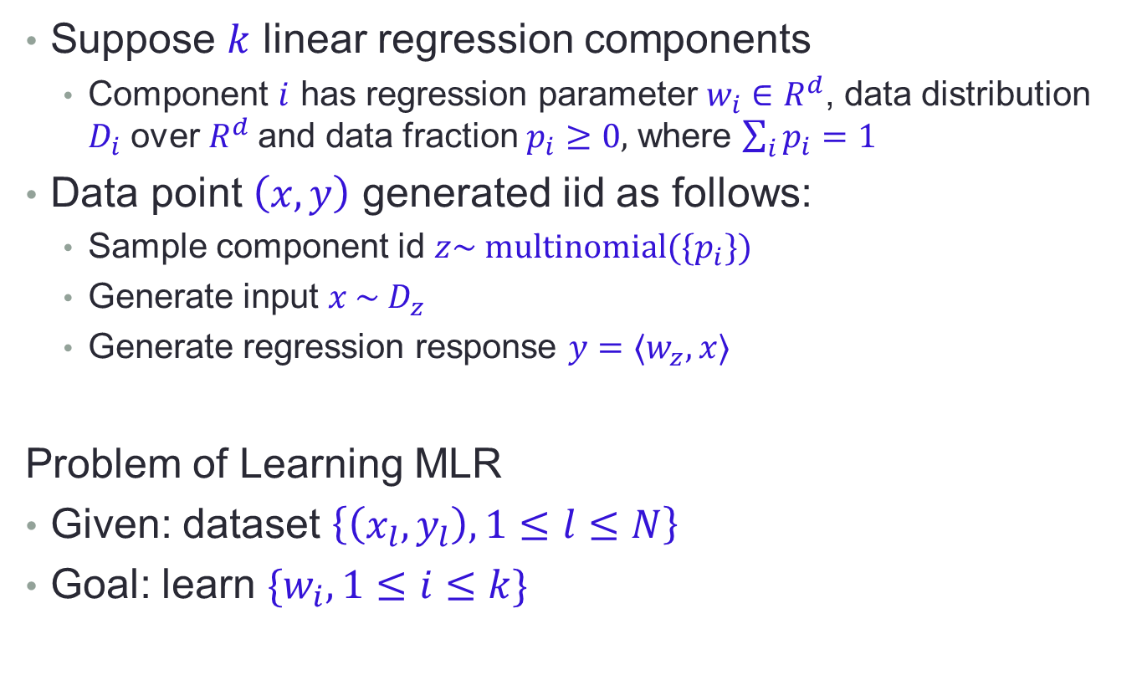
Problem Definition
Suppose $k$ linear regression components
  Component $i$ has regression parameter $w_{i}∈R^{d}$, data distribution $D_{i}$ over $R^{d}$and data fraction $p_{i}≥0,$ where $\sum_{i}{p_{i}=1}$
Data point $\left(x,y\right)$ generated iid as follows:
  Sample component id $z\sim multinomial({\{p}_{i}\})$
  Generate input $x \sim D_{z}$
  Generate regression response $y=⟨w_{z},x⟩$
Problem of Learning MLR
Given: dataset $\left\{\left(x_{l},y_{l}\right), 1≤l≤N\right\}$
Goal: learn ${\{w}_{i}, 1≤i≤k\}$
Notes:
Our focus: the dependence of sample/computational complexity on the dimension d

Slide 8
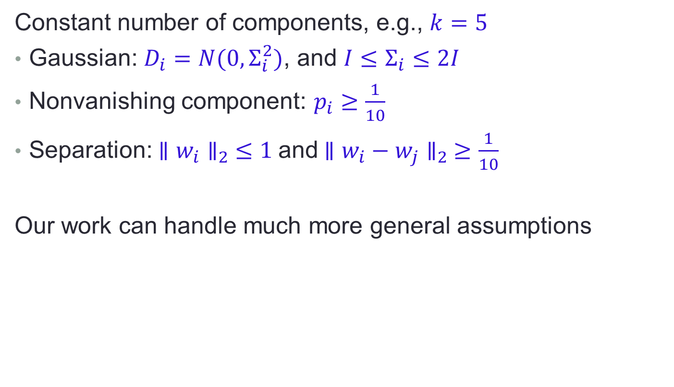
A Simplified Setting
Constant number of components, e.g., $k=5$
Gaussian: $D_{i}=N(0,Σ_{i}^{2})$, and ${I≤Σ}_{i}≤2I$
Nonvanishing component: $p_{i}≥\frac{1}{10}$
Separation:$∥{w_{i}∥}_{2} ≤1$and $∥w_{i}−w_{j}∥_{2} ≥\frac{1}{10}$
Our work can handle much more general assumptions
Notes:
First we assume that the input data is Gaussian. That is, the data D_i is a gaussian with covariance \Sigma_i^2. We allow different components to have different covariances, and their difference is bounded by a parameter \sigma.
The second assumption is that each component takes up a non-vanishing fraction of the overall data
The third assumption is that the weight parameters can be separated. In particular, assume they have bounded norm, and the distance is bounded away from 0
We emphasize that the last two assumptions are essentially necessary. For example, we will need the regression parameters to be somewhat different to have any recovery guarantees. So our only key assumption is the first assumption. This is more general than those in existing work; most of them assume that the data distributions are just the same and is the standard Gaussian.

Slide 9
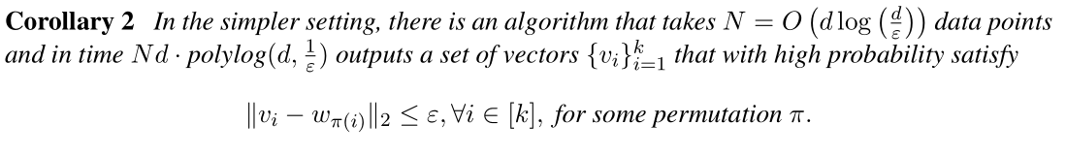
Main Result for the Simplified Setting
Global convergence, recovery to any accuracy
Sample/Computational complexity has nearly optimal dependence on the dimension
Notes:
we propose an algorithm that whp recovers the ground-truth up to accuracy eps. The sample size has two terms, the first is d times log d/eps times other parameters, and the second term does not depend on d so we regard it as a minor term. The run time is the sample size times d times some polylog terms, nearly the same order of the time for reading the data.
A few remarks. First we have global convergence without given a warm start. In fact our algo first computes a warm start by itself. At the end of the day, it can recover the ground truth to any accuracy.
Second, the complexity has nearly optimal dependence on the dimension
Finally, we note that we have an exponential dependence on #components. This may be necessary, since in a similar setting of learning mixture of Gaussians, such an exponential dependence has been shown to be necessary.

Slide 10
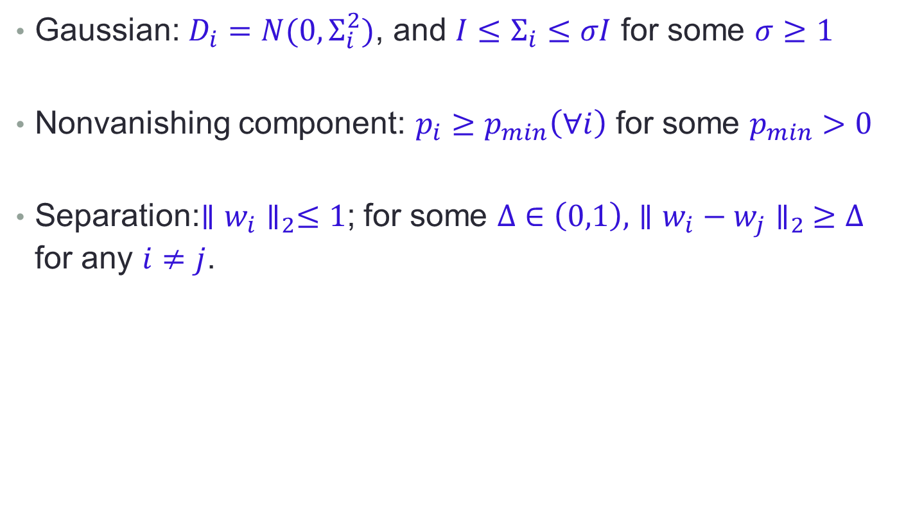
General Setting
Gaussian: $D_{i}=N(0,Σ_{i}^{2})$, and ${I≤Σ}_{i}≤σI$ for some $σ≥1$
Nonvanishing component: $p_{i}≥p_{min}\left(∀i\right)$ for some $p_{min}>0$
Separation:$∥w_{i}∥_{2}≤1$; for some $Δ∈\left(0,1\right),$ $∥w_{i}−w_{j}∥_{2} ≥Δ$ for any $i≠j$.
Notes:
First we assume that the input data is Gaussian. That is, the data D_i is a gaussian with covariance \Sigma_i^2. We allow different components to have different covariances, and their difference is bounded by a parameter \sigma.
The second assumption is that each component takes up a non-vanishing fraction of the overall data
The third assumption is that the weight parameters can be separated. In particular, assume they have bounded norm, and the distance is bounded away from 0
We emphasize that the last two assumptions are essentially necessary. For example, we will need the regression parameters to be somewhat different to have any recovery guarantees. So our only key assumption is the first assumption. This is more general than those in existing work; most of them assume that the data distributions are just the same and is the standard Gaussian.

Slide 11
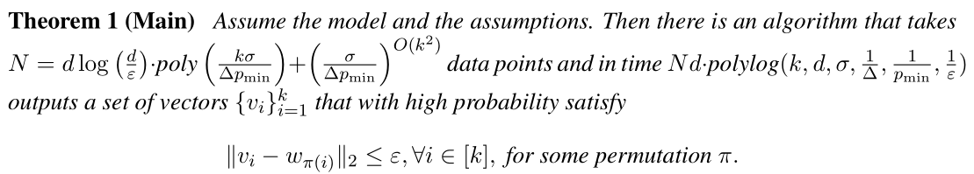
Main Result
Global convergence, recovery to any accuracy
Sample/Computational complexity has nearly optimal dependence on the dimension
Exponential dependence on #components
Notes:
we propose an algorithm that whp recovers the ground-truth up to accuracy eps. The sample size has two terms, the first is d times log d/eps times other parameters, and the second term does not depend on d so we regard it as a minor term. The run time is the sample size times d times some polylog terms, nearly the same order of the time for reading the data.
A few remarks. First we have global convergence without given a warm start. In fact our algo first computes a warm start by itself. At the end of the day, it can recover the ground truth to any accuracy.
Second, the complexity has nearly optimal dependence on the dimension
Finally, we note that we have an exponential dependence on #components. This may be necessary, since in a similar setting of learning mixture of Gaussians, such an exponential dependence has been shown to be necessary.

Slide 12
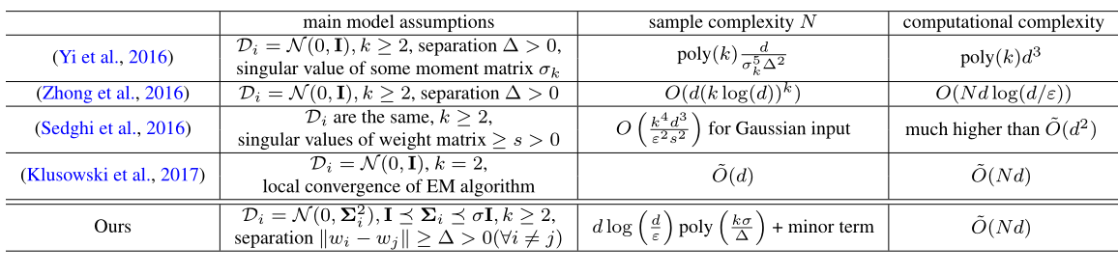
Comparison with Existing Work
Our assumptions are cleaner and more general
Better sample/computational complexity
Notes:
Existing work either requires some complicated assumptions like bounded singular value of some moment matrix, or is restricted to some special case like all data distributions are the standard Gaussian.
Our sample/computational complexity bounds are in general better than those in existing work
15 min

Slide 13
Algorithm/Analysis Overview
Let’s focus on learning one of the regression weights
  Once learned, can remove points from that component and repeat
Two phases for learning one weight
  Moment Descent to get a warm start
    Method of Moments for incremental update
  Gradient Descent to get an accurate solution
    Specific designed concave objective function
Notes:
The first is to get a warm start point using a technique we called moment descent. The second phase is to get an accurate solution from the warm start point by doing gradient descent.

Slide 14

Warm Start I: Overview
Maintain $a_{t}$ at iteration $t$, and update it by
$$a_{t+1}=a_{t}+η r_{t}$$
so that $\min_{i}\{∥Σ_{i}\left(a_{t}−w_{i}\right)∥_{2}\}$ gets smaller and smaller
Notes:
The overall plan is to iterate in steps. At each step we maintain a solution a_t, and update it by moving towards some direction r_t, so that the distance between a_t and some weight is smaller and smaller.

Slide 15

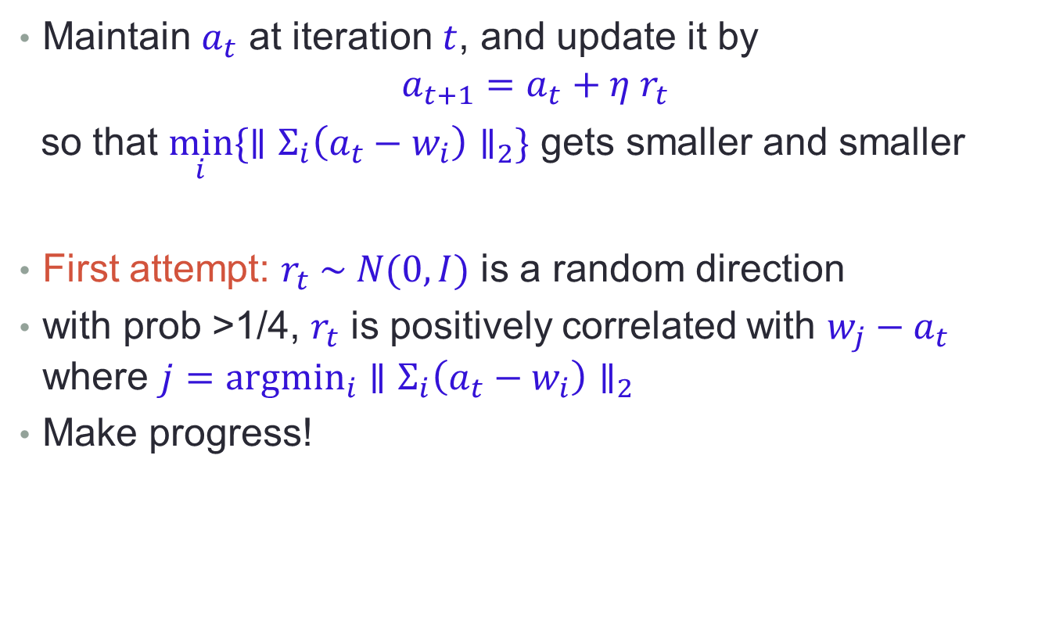
Warm Start I: Overview
Maintain $a_{t}$ at iteration $t$, and update it by
$$a_{t+1}=a_{t}+η r_{t}$$
so that $\min_{i}\{∥Σ_{i}\left(a_{t}−w_{i}\right)∥_{2}\}$ gets smaller and smaller
First attempt: $r_{t} \sim N(0,I)$ is a random direction
with prob >1/4, $r_{t}$ is positively correlated with $w_{j}−a_{t}$ where $j=argmin_{i}$ $∥Σ_{i}\left(a_{t}−w_{i}\right)∥_{2}$
Make progress!
Notes:
For demonstration, let’s try to sample a random direction r_t. With constant probability, the random direction is positively correlated with the right direction pointing towards w_j, where w_j is the closest regression parameter. So we can repeatedly sample a random direction and test if this nice event happens, if so, we then update a_t and make progress.

Slide 16

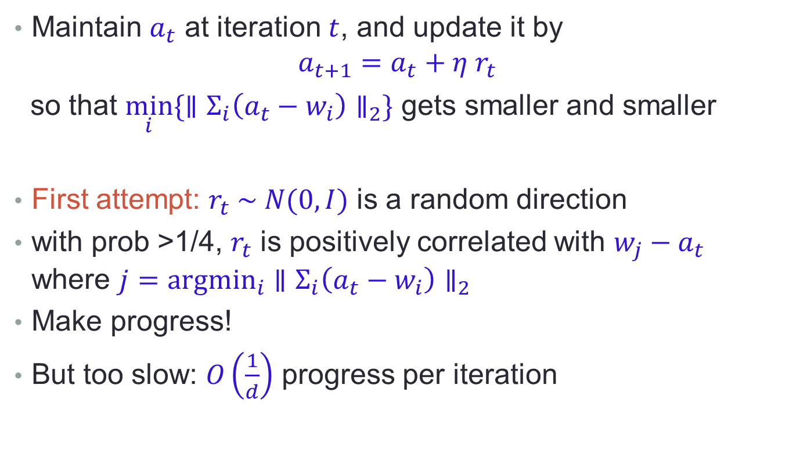
Warm Start I: Overview
Maintain $a_{t}$ at iteration $t$, and update it by
$$a_{t+1}=a_{t}+η r_{t}$$
so that $\min_{i}\{∥Σ_{i}\left(a_{t}−w_{i}\right)∥_{2}\}$ gets smaller and smaller
First attempt: $r_{t} \sim N(0,I)$ is a random direction
with prob >1/4, $r_{t}$ is positively correlated with $w_{j}−a_{t}$ where $j=argmin_{i}$ $∥Σ_{i}\left(a_{t}−w_{i}\right)∥_{2}$
Make progress!
But too slow: $O\left(\frac{1}{d}\right)$ progress per iteration
Notes:
Unfortunately, the progress is too slow. Some calculation shows that one can decrease the distance by only O(1/d) per iteration, leading to a large sample complexity and computational complexity. Intuitively, this is because we are sampling randomly in d dimension, and whp the correlation is as small as 1/d. Then a natural idea is to restrict our sample space.

Slide 17

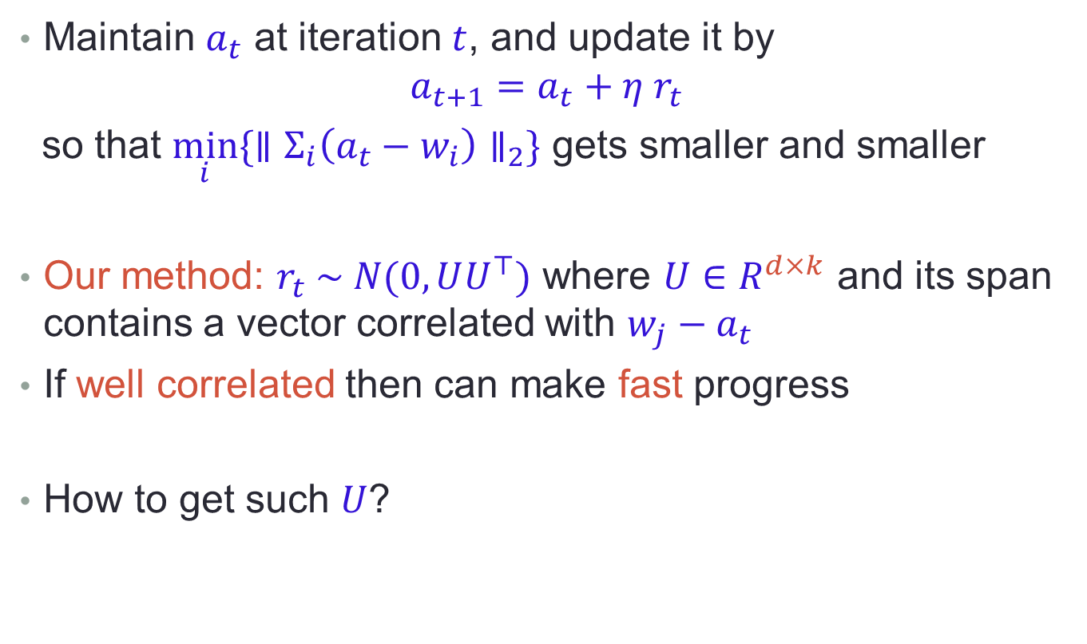
Warm Start I: Overview
Maintain $a_{t}$ at iteration $t$, and update it by
$$a_{t+1}=a_{t}+η r_{t}$$
so that $\min_{i}\{∥Σ_{i}\left(a_{t}−w_{i}\right)∥_{2}\}$ gets smaller and smaller
Our method: $r_{t} \sim N(0,UU^{⊤})$ where $U∈R^{d×k}$ and its span contains a vector correlated with $w_{j}−a_{t}$
If well correlated then can make fast progress
How to get such $U$?
Notes:
Here is our second attempt: sample the direction r_t from a subspace U of dimension k. If the subspace has a good correlation with the right direction, we can make fast progress since now r_t is sampled from dimension k and whp the correlation is large.

Slide 18
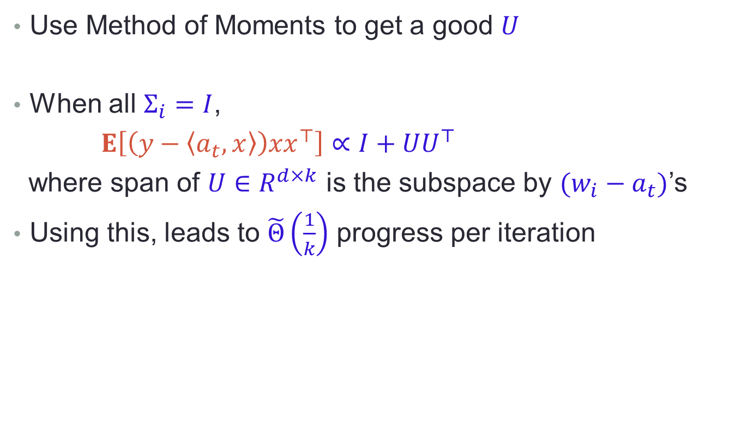
Warm Start II: Method of Moments
Use Method of Moments to get a good $U$
When all $Σ_{i}=I$,
$E\left[\left(y−\left\langle a_{t},x\right\rangle \right)xx^{⊤}\right]∝I+UU^{⊤}$
where span of $U∈R^{d×k}$ is the subspace by $(w_{i}−a_{t})$’s
Using this, leads to $\tilde{Θ}\left(\frac{1}{k}\right)$ progress per iteration
Notes:
Here is where we turn to the method of moments.
Consider the simple case where all data distributions are just the standard Gaussian. If we compute the error …, times xx^t and then take the expectation, we can show that the expectation is proportional to I+UU^t, where U is of rank k and the span of U is the span of w_i – a_t’s. This satisfies our requirement, so we can sample random directions from this U, and then update the solution if we find positive correlations. This leads to 1/k progress.

Slide 19
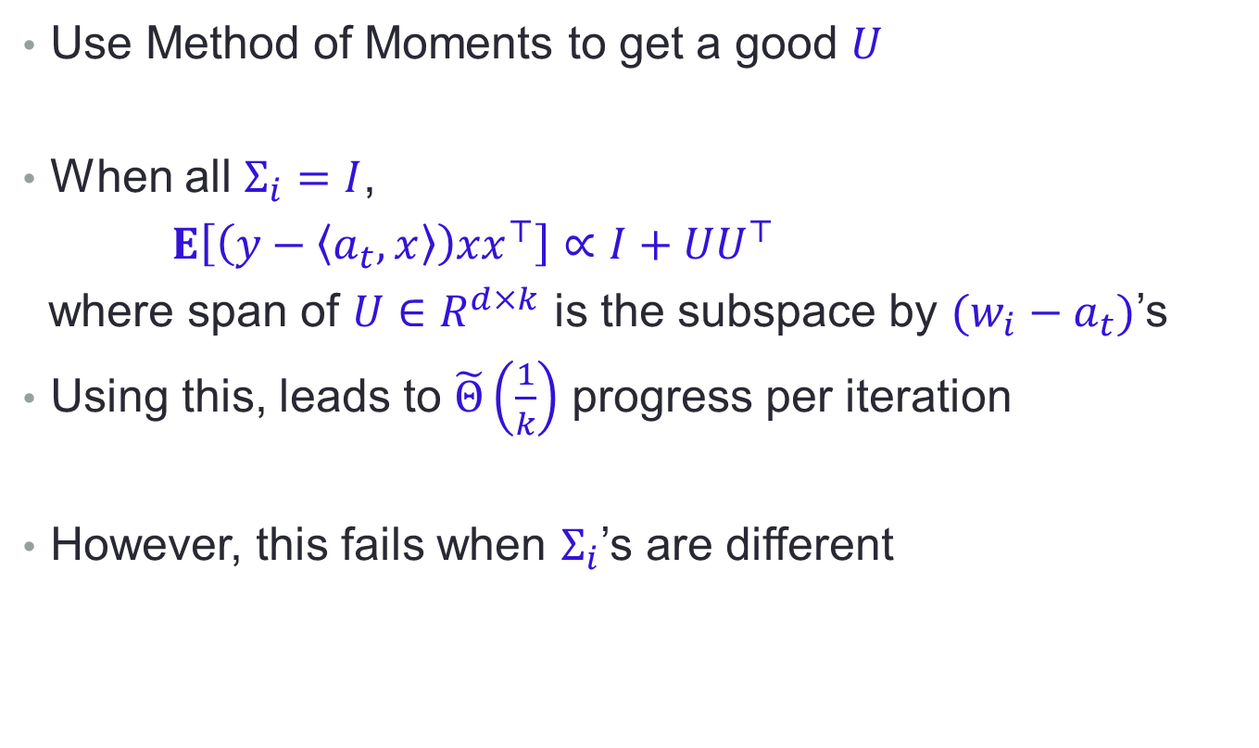
Warm Start II: Method of Moments
Use Method of Moments to get a good $U$
When all $Σ_{i}=I$,
$E\left[\left(y−\left\langle a_{t},x\right\rangle \right)xx^{⊤}\right]∝I+UU^{⊤}$
where span of $U∈R^{d×k}$ is the subspace by $(w_{i}−a_{t})$’s
Using this, leads to $\tilde{Θ}\left(\frac{1}{k}\right)$ progress per iteration
However, this fails when $Σ_{i}$’s are different
Notes:
Unfortunately this fails when the data distributions of different components have different covariances. In this case, the expectation will have terms related to $(w_{i}−a_{t})$’s that can be regarded as signals, but also some other terms that can be regarded as large noise

Slide 20
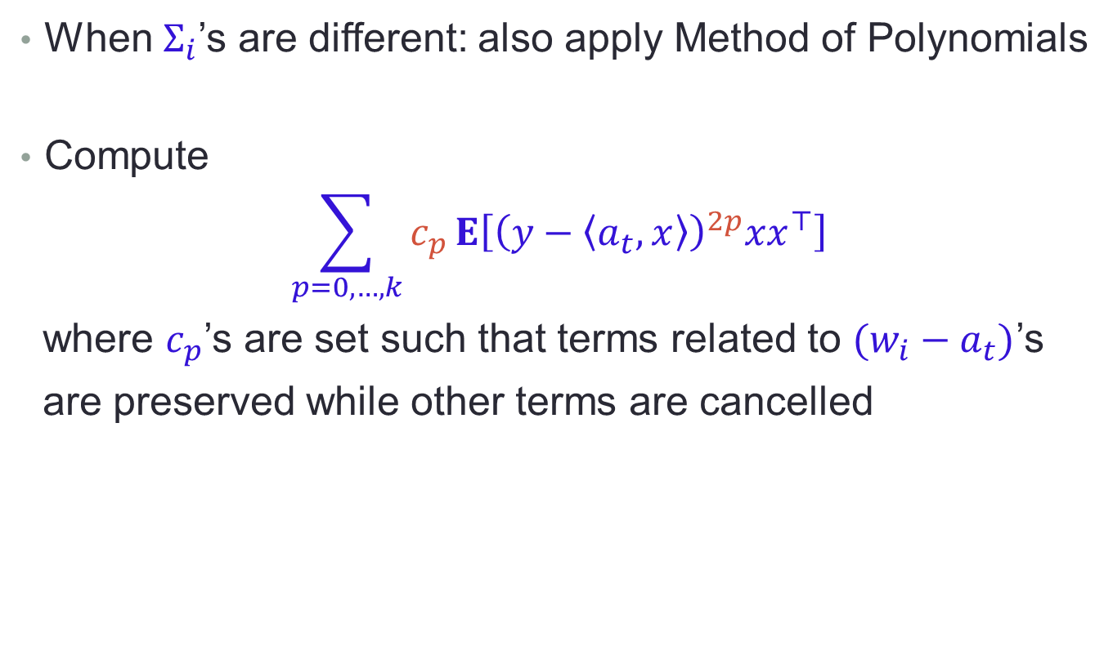
Warm Start III: Method of Polynomials
When $Σ_{i}$’s are different: also apply Method of Polynomials
Compute
$$\sum_{p=0,…,k}{c_{p}}E\left[{\left(y−\left\langle a_{t},x\right\rangle \right)}^{2p}xx^{⊤}\right]$$
where $c_{p}$’s are set such that terms related to $(w_{i}−a_{t})$’s
are preserved while other terms are cancelled
Notes:
So we use higher order moments and apply the polynomial method to combine them. In particular, we raise the power of y-<a_t, x> to 2p , and take a weighted combination of these higher order terms. The weights c_p’s are carefully designed such that the useful terms are preserved and the noisy terms get cancelled out.

Slide 21
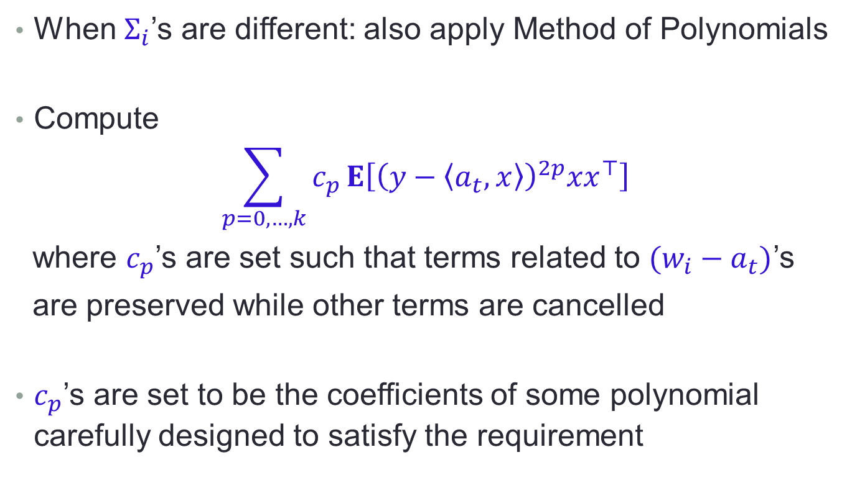
Warm Start III: Method of Polynomials
When $Σ_{i}$’s are different: also apply Method of Polynomials
Compute
$$\sum_{p=0,…,k}{c_{p}}E\left[{\left(y−\left\langle a_{t},x\right\rangle \right)}^{2p}xx^{⊤}\right]$$
where $c_{p}$’s are set such that terms related to $(w_{i}−a_{t})$’s
are preserved while other terms are cancelled
$c_{p}$’s are set to be the coefficients of some polynomial carefully designed to satisfy the requirement
Notes:
We use the polynomial method to design the weights c_p’s. They are set to be the coefficients of some polynomial we designed so that the weighted combination of the higher order moments satisfies our requirement of preservation and cancellation. Using this we can get a good subspace U and sample update directions from U, and then make fast progress; after a few steps we get a warm start.

Slide 22
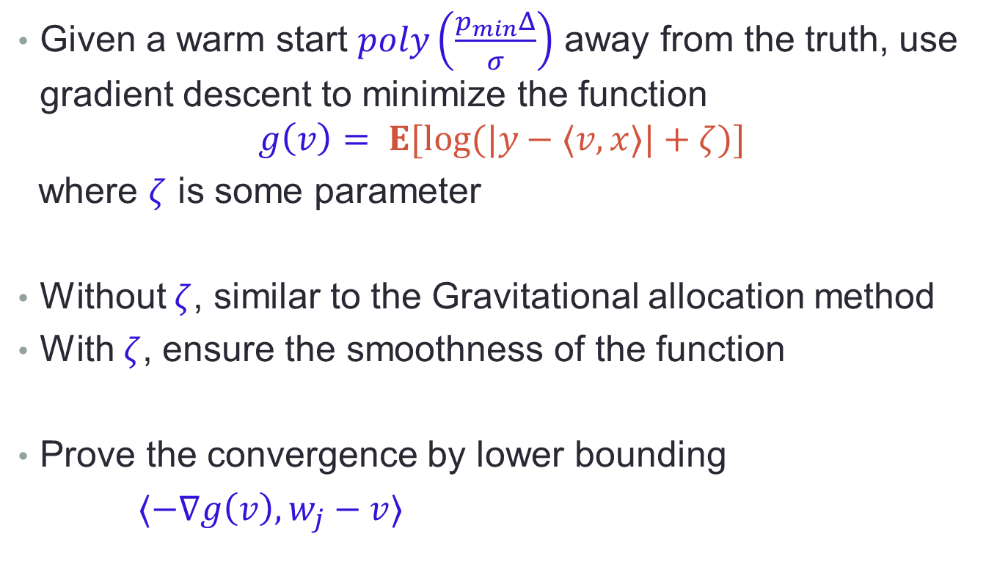
Gradient Descent from Warm Start
Given a warm start $poly\left(\frac{p_{min}Δ}{σ}\right)$ away from the truth, use gradient descent to minimize the function
$$g\left(v\right)= E[log⁡(|y−⟨v,x⟩|+ζ)]$$
where $ζ$ is some parameter
Without $ζ$, similar to the Gravitational allocation method
With $ζ$, ensure the smoothness of the function
Prove the convergence by lower bounding
$⟨−∇g\left(v\right),w_{j}−v⟩$
Notes:
Once we get a warm start, we enter our second phase. In this phase, initialized with the warm start, we use gradient descent to minimize the objective function g(v). g(v) is the expectation of the log of the absolute error plus some zeta parameter. Without zeta, …; however, when the error is small, the log is not so smooth, so we add zeta so that the function is smooth.
We prove the convergence by showing that the negative gradient correlates with the right direction pointing to the ground truth. After a few steps this gives a solution epsilon close to the ground truth. This completes our analysis.
25 min

Slide 23
Conclusion
Algorithm for learning Mixture of Linear Regressions in a quite general setting
Achieves sample and computational complexity nearly optimal in the dimension
Based on “Moment Descent” technique, which may be of independent interest

