Slide 1
Data Science and Machine Learning at American Family Insurance
Midwest Machine Learning Symposium
June 6, 2018

Slide 2
Data Science & AI for Insurance
Awareness & Purchase
Customer Service & Experience
Product & Underwriting
Claim
Marketing Mix & Optimization Prospect & Response Models Sales Performance & Capacity | Recommendation Engine Customer Lifetime Value Customer Retention Customer Satisfaction Virtual Assistants | Pricing Sophistication – usage-based insurance UW Predictive Models Image recognition – dwelling condition, life insurance (BMI) | Claims Insurance Risk – property & injury, legal risk, fraud Claims Operations – Subrogation, capacity Claims Satisfaction
Key Focus Areas for Research
Customer journey & experience
Customer interaction management
NLP – knowledge extraction, entity matching, cognition
IOT & Telematics – UBI, connected car, smart home
Claims risk management & fraud detection
Image recognition – Underwriting & Claims

Slide 3
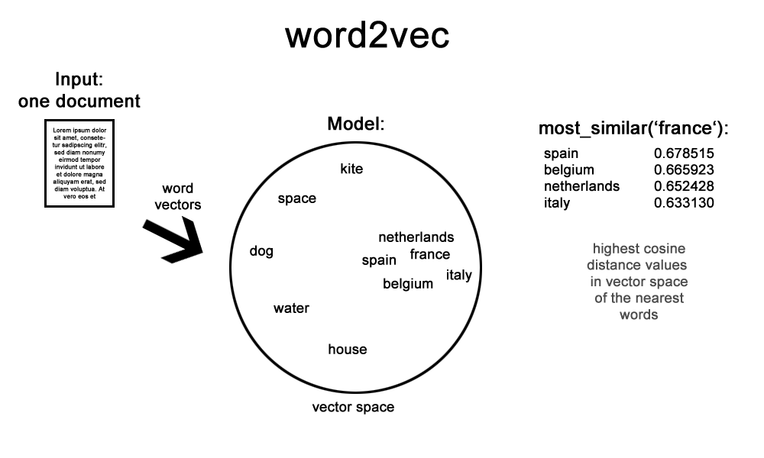
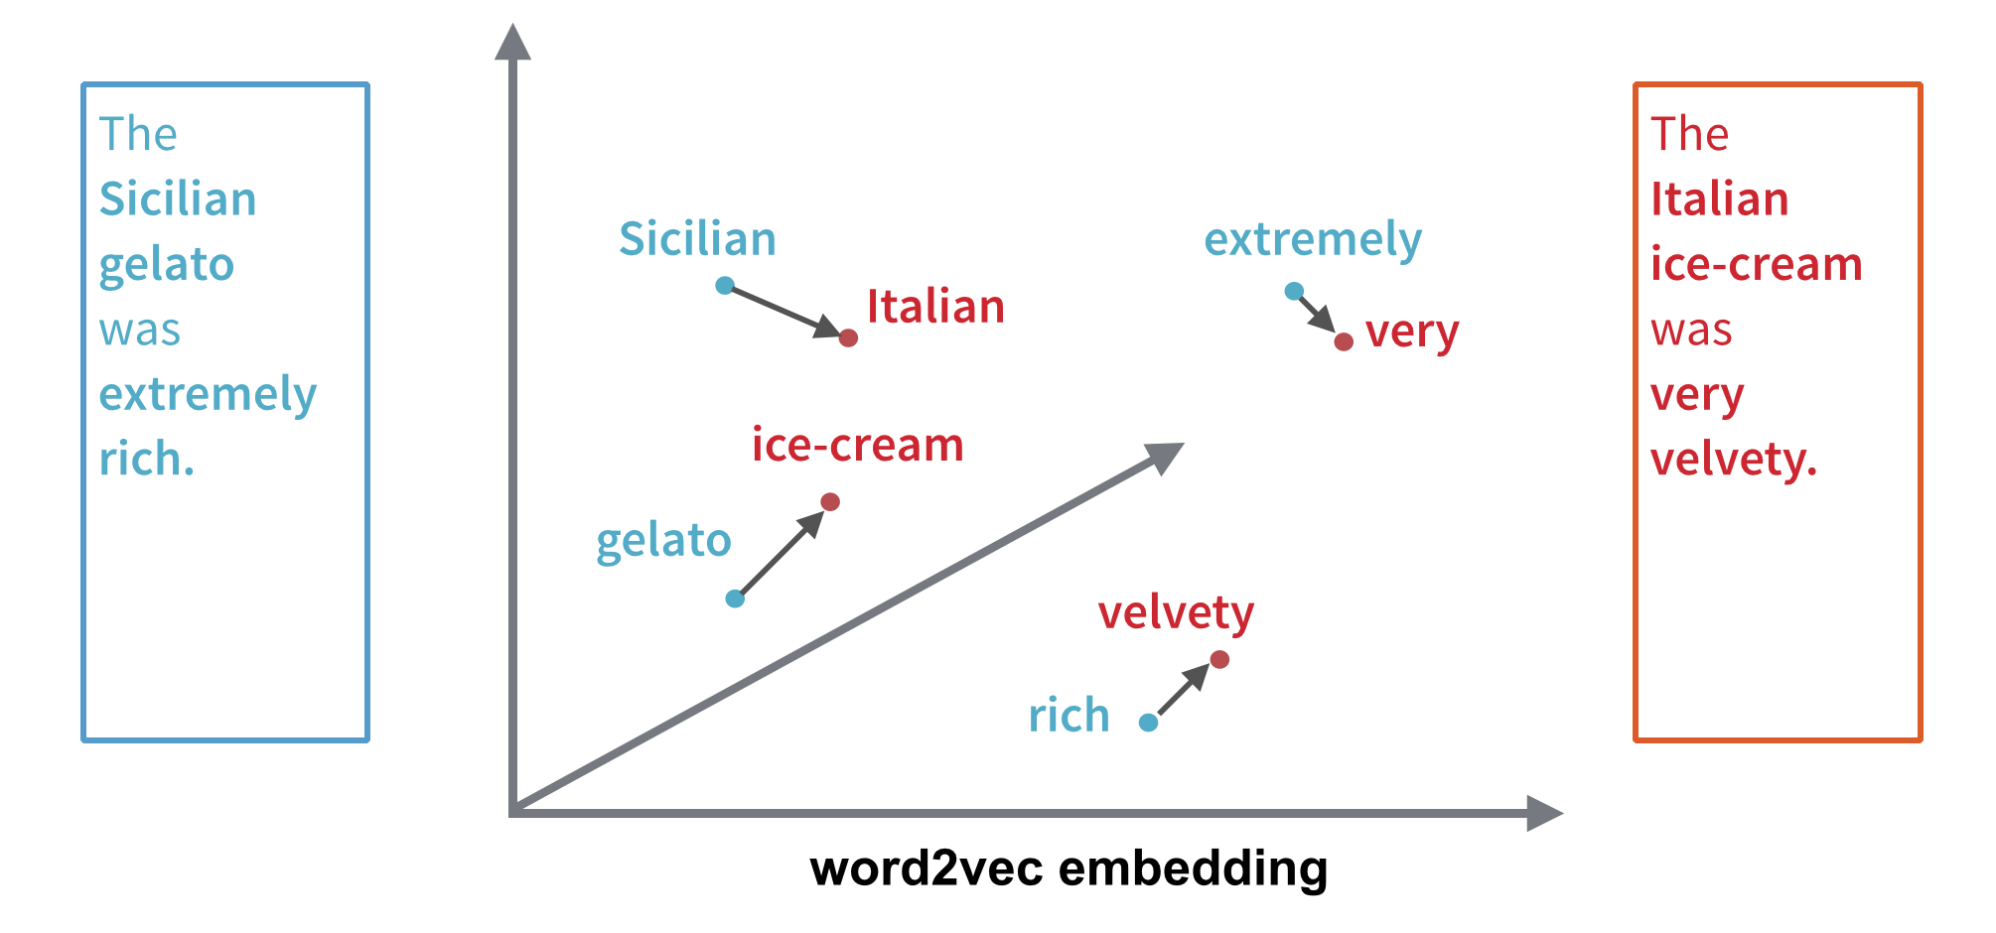
Homebrew text learning platform - Rocket
Our secret sauce: Word-embedding models trained from 500MM Claim notes.

Slide 4
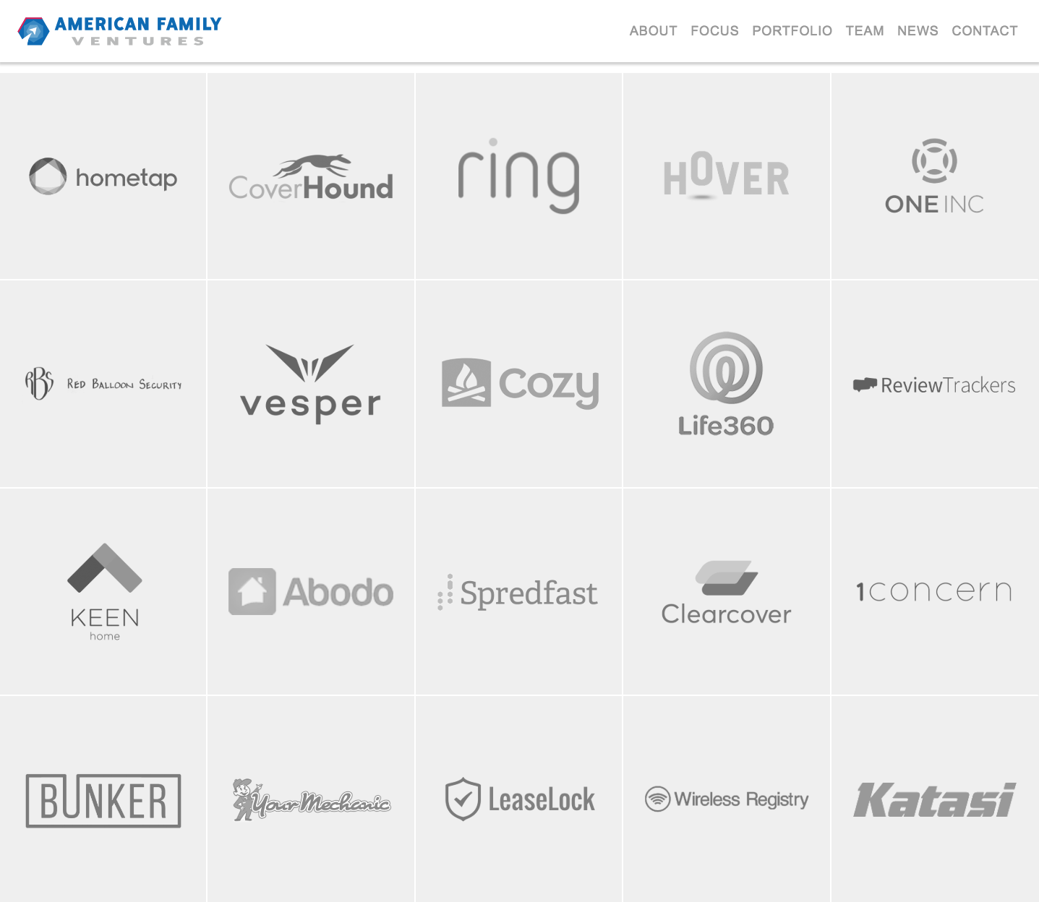
Partners and novel data sources

Slide 5
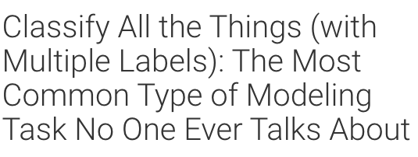
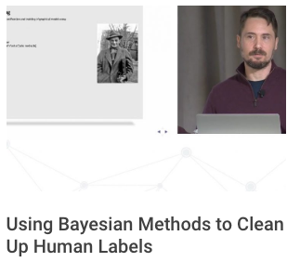
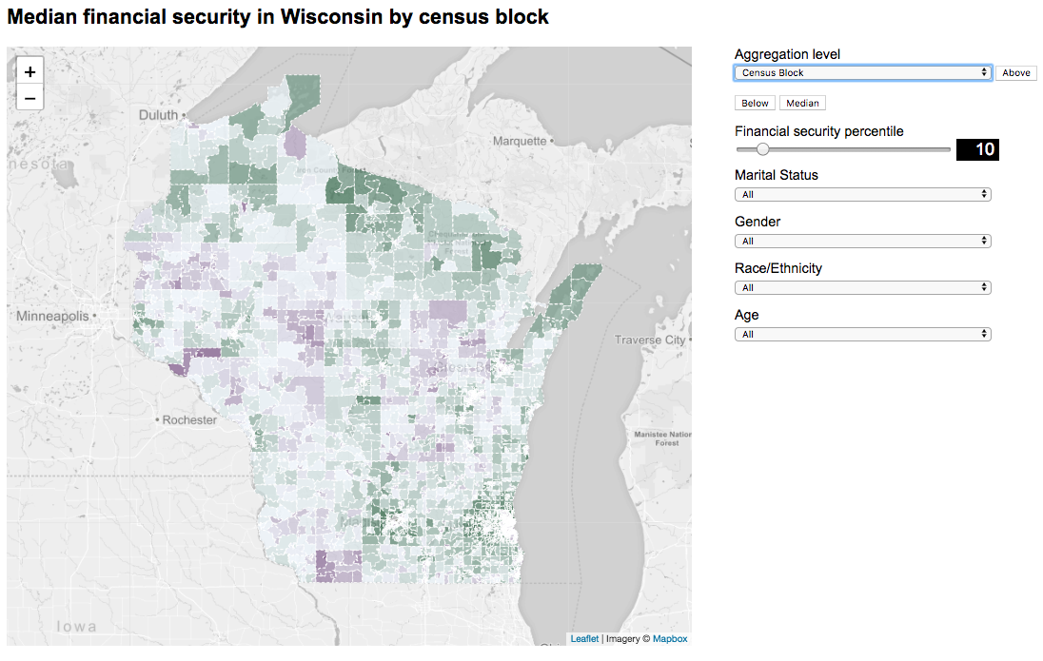
Technical challenges: new product development

